Slide 1

A
Major Project
On
Quality Risk Analysis for Sustainable Smart Water Supply Using Data Perception
(Submitted in partial fulfillment of the requirements for the award of Degree)
BACHELOR OF TECHNOLOGY
In
COMPUTER SCIENCE AND ENGINEERING
By
RACHAMALLA SINDHUJA(197R1A05P4)
KOTA VENKATA NIKHIL(197R1A05M1)
G.J MANIKANTA VARMA(197R1A05K8)
Under the Guidance of
B.P DEEPAK KUMAR
(Assistant Professor)
DEPARTMENT OF COMPUTER SCIENCE AND ENGINEERING
CMR TECHNICAL CAMPUS
UGC AUTONOMOUS
(Accredited by NAAC, NBA, Permanently Affiliated to JNTUH, Approved by AICTE, New Delhi) Recognized Under
Section 2(f) & 12(B) of the UGCAct.1956, Kandlakoya (V), Medchal Road, Hyderabad-501401.
2019-2023

Slide 2
ABSTRACT
Constructing Sustainable Smart Water Supply systems is facing serious challenges all around the world with the fast expansion of modern cities. Water quality is influencing our life ubiquitously and prioritizing all urban management.
Traditional urban water quality control mostly focused on routine tests of quality indicators, which include physical, chemical, and biological groups. However, the inevitable delay for biological indicators has increased the health risk and led to accidents such as massive infections in many big cities.
In this paper, we provide a possible solution by building a risk analysis framework for the urban water supply system. It takes indicator data we collected from industrial processes to perceive water quality changes, and further for risk detection. In order to provide explainable results, we propose an Adaptive Frequency Analysis (Adp-FA) method to resolve the data using indicators’ frequency domain information for their inner relationships and individual prediction.
We employ the proposed method to test spectrogram, prediction accuracy, and time consumption, comparing with classical Artificial Neural Network and Random Forest methods.

Slide 3
Traditional water quality control is taken after water treatment. But the current water sources are mainly groundwater and surface water.
They are significantly prone to chemical and microbial contamination. The quality control after the water treatment apparently delays risk detection and reduces the response time to take preventive measures.
Water quality refers to physical, chemical, and biological characteristics as indicators. Among the water quality indicators, biological indicators have a more direct impact on people’s health. Most of the national standards are made on biological indicator levels.
Typical indicators include coliform, escherichia coli (Ecoli), intestinal enterococci (Int), clostridium perfringens (ClPerf), etc.
Further treatment actions are made according to the test results. Coliform itself is not usually causing serious illness, but its presence is a signal to indicate other active pathogenic organisms' presentation.
EXISTING
SYSTEM

Slide 4

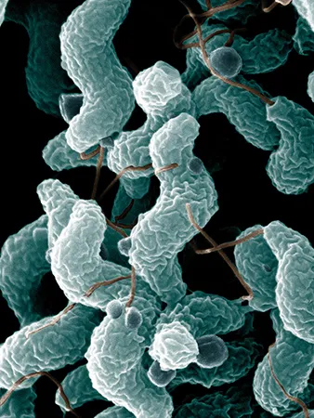
EXISTING SYSTEM'S
DISADVANTAGES
1. Traditional urban water quality control mostly focused on routine tests of quality indicators, which include physical, chemical, and biological groups.
2. However, the inevitable delay for biological indicators has increased health risks and led to accidents such as massive infections in many big cities.

Slide 5
PROPOSED
In this paper, we first analyze the problem, technical challenges, and research questions. Then, we provide a possible solution by building a risk analysis framework for the urban water supply system.
It takes indicator data we collected from industrial processes to perceive water quality changes, and further for risk detection. In order to provide explainable results, we propose an Adaptive Frequency Analysis (Adp-FA) method to resolve the data using indicators’ frequency domain information for their inner relationships and individual prediction.
We also investigate the scalability properties of this method from the indicator, geography, and time domains. For the application, we select industrial quality data sets collected from a Norwegian project in four different urban water supply systems, Oslo, Bergen, Strømmen, and Ålesund.
We employ the proposed method to test spectrogram, prediction accuracy, and time consumption, comparing with classical Artificial Neural Network and Random Forest methods.
SYSTEM

Slide 6
ADVANTAGES
The Advantages of this proposed system are
2. IT IS FEASIBLE TO SUPPORT INDUSTRIAL WATER QUALITY RISK EARLY WARNINGS AND FURTHER DECISION SUPPORT.
1. THE RESULTS SHOW OUR METHOD BETTER PERFORM IN MOST OF THE ASPECTS.

Slide 7



HARDWARE
REQUIREMENTS
SYSTEM
STORAGE SPACE
MEMORY
A Minimum requirement of a single-core CPU
At least 4GB of free space
A minimum of 512MB of RAM

Slide 8
SOFTWARE
REQUIREMENTS
Operating System: Windows 7+
Programming Language: Python 3.7
Libraries Used: Pandas, sk-learn, Numpy, Flask

Slide 9
The novelty of this project (Quality Risk Analysis for Sustainable Smart Water Supply Using Data Perception) is that, In this paper, we first analyze the problem, technical challenges, and research questions.
Then, we provide a possible solution by building a risk analysis framework for the urban water supply system.
In order to provide explainable results, we propose an Adaptive Frequency Analysis (Adp-FA) method to resolve the data using indicators’ frequency domain information for their inner relationships and individual prediction.
We also investigate the scalability properties of this method from the indicator, geography, and time domains. We employ the proposed method to test spectrogram, prediction accuracy, and time consumption, comparing with classical Artificial Neural Network and Random Forest methods.
It is feasible to support industrial water quality risk early warnings and further decision support.
NOVELTY

Slide 10
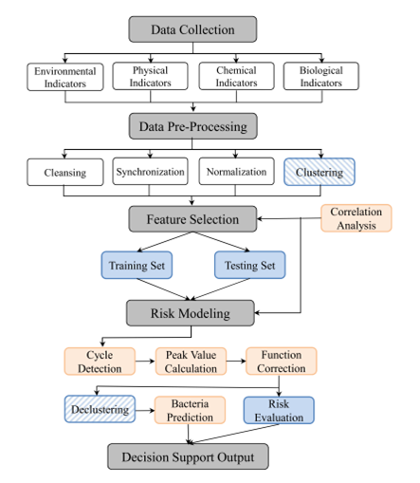
ARCHITECTURE

Slide 11
MODULES
Data Collection: This step was done by the original owners of the dataset. And the composition of the dataset.
Data Preprocessing: The data which was collected might contain missing values that may lead to inconsistency. To gain better results data need to be preprocessed so as to improve the efficiency o the algorithm.
Model Selection: It’s vital to split the data into training and test sets first. So before training our models, we split the data into Training set which was 70% of the whole dataset and Test set which was the remaining 30%.
Predict the results: The designed system is tested with test set and the performance is assured.

Slide 12
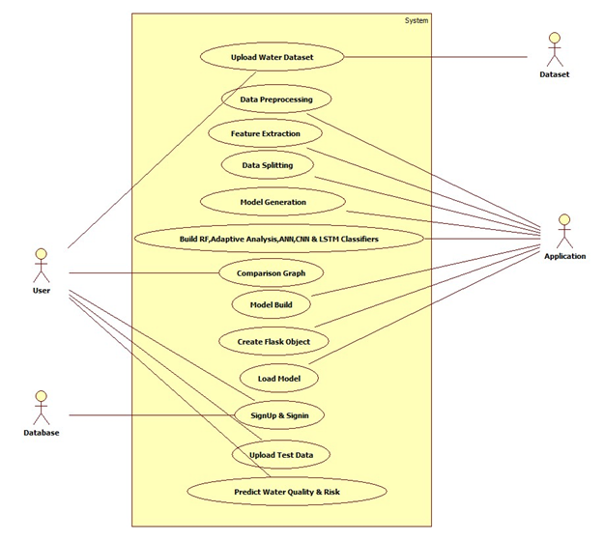
UML DIAGRAMS
USE CASE DIAGRAM

Slide 13
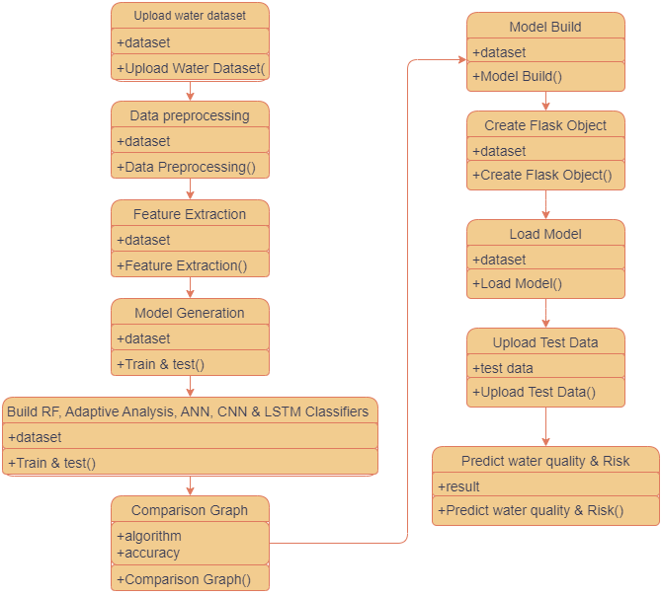
UML DIAGRAMS
CLASS DIAGRAM

Slide 14
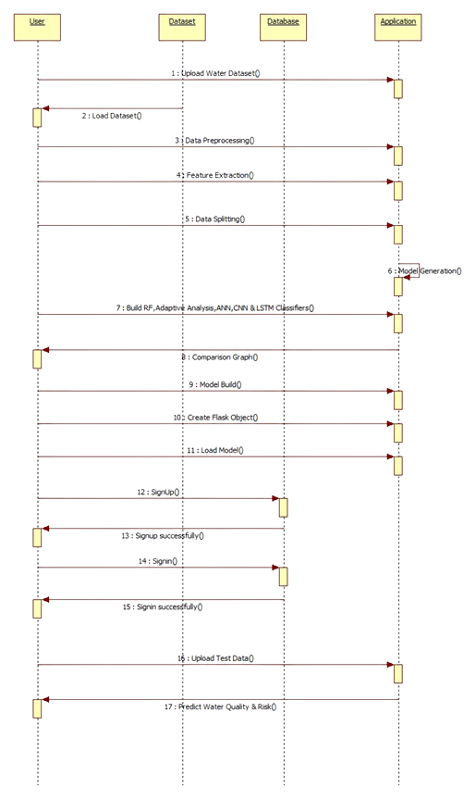
UML DIAGRAMS
SEQUENCE DIAGRAM
X
X
X
X

Slide 15
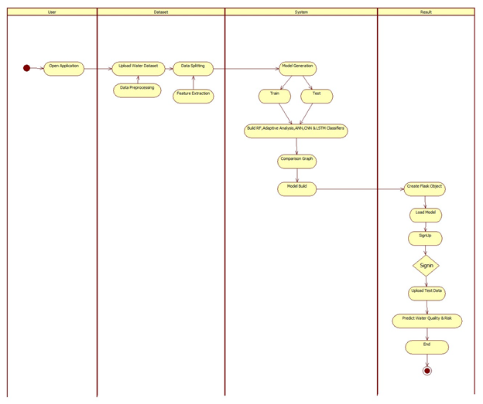
UML DIAGRAMS
ACTIVITY DIAGRAM
X
X
X
X
X

Slide 16
SAMPLE CODE
from flask import Flask, request, render_template
import pickle
import pandas as pd
import numpy as np
import joblib
scaler = joblib.load("my_scaler.save")
app = Flask(_name_)
model=pickle.load(open('model.pkl','rb'))
@app.route("/home")
@app.route("/")
def hello():
return render_template("predict.html")
@app.route("/predict", methods = ["GET", "POST"])
def predict():
if request.method == "POST":
input_features = [float(x) for x in request.form.values()]
features_value = [np.array(input_features)]

Slide 17
SAMPLE CODE
"feature_names = ["ph", "Hardness" , "Solids", "Chloramines", "Sulfate",
"Conductivity", "Organic_carbon","Trihalomethanes", "Turbidity"]
df = pd.DataFrame(features_value, columns = feature_names)
df = scaler.transform(df)
output = model.predict(df)
if output[0] == 1:
prediction = "safe"
else:
prediction = "not safe"
return render_template('predict.html', prediction_text= "water is {} for human consumption ".format(prediction))
if _name_ == "_main_":
app.run(debug=True)

Slide 18
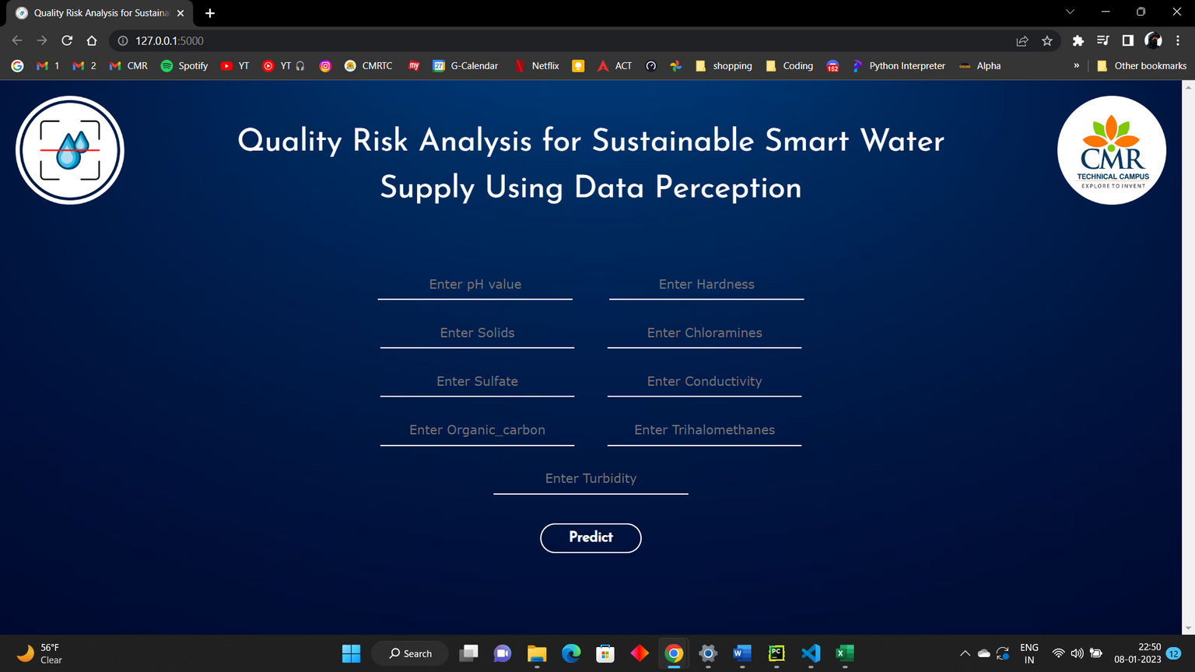
RESULTS
Landing page

Slide 19
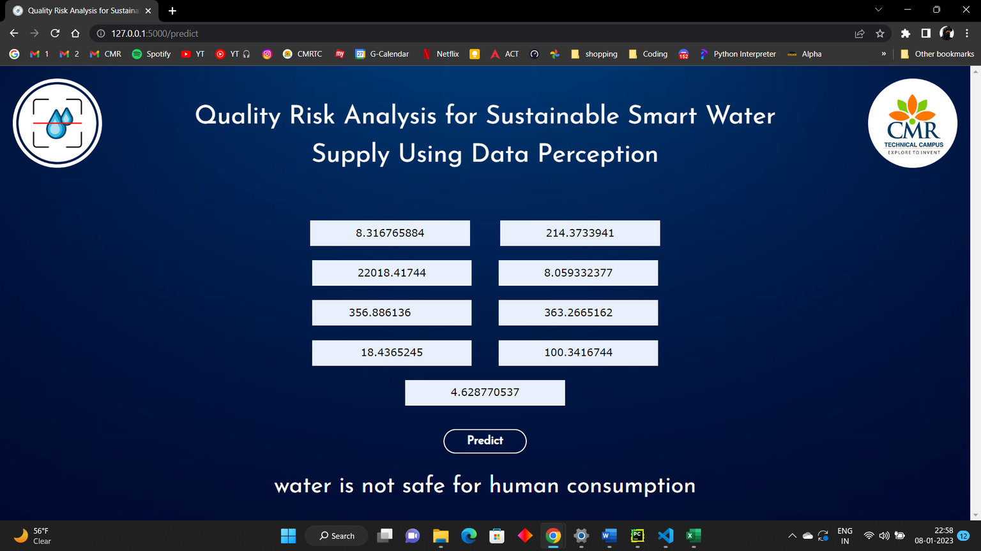
RESULTS
model predicted water not safe for consumption

Slide 20
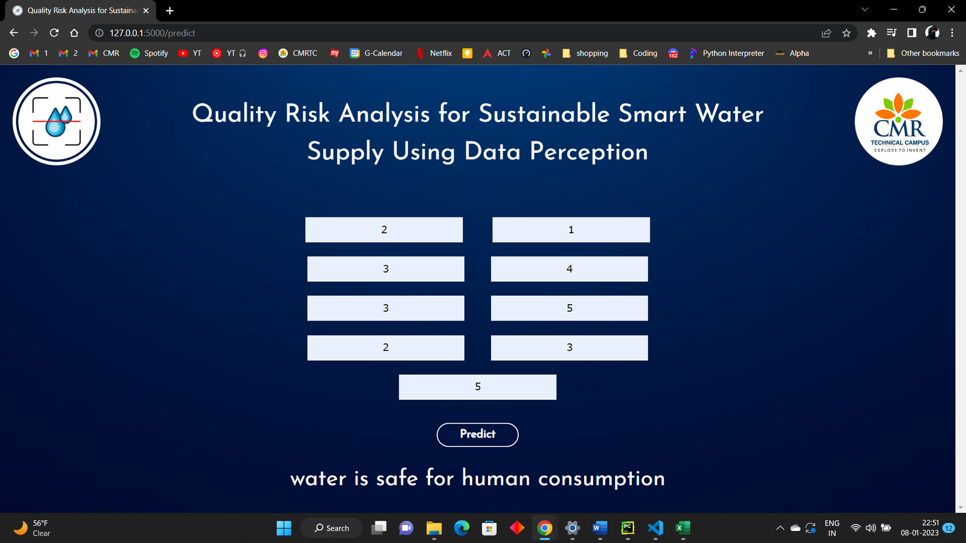
RESULTS
model predicted water safe for consumption

Slide 21
CONCLUSION
Water quality is a very critical issue in modern urban life all around the world, especially for Smart Water Supply system development.
Traditional monitoring and risk control methods are difficult to detect bacteria broadcast on time and provide efficient decision support. In this paper, we propose an approach for water quality risk early warning using data perception.
The preliminary results evaluated by domain experts are very promising. This work is beneficial in generally three aspects: It provides an early warning mechanism from the water source areas using cost-less data analysis techniques.
This prolongs the preventive measures response time, and support more decision options in the latter steps of water supply. This approach integrates indicator, geography and time domains.
It provides a new frequency domain analysis perspective to find the relationship between different indicators and their predictions. At the same time, it embraces scalability for these three domains. This work is applied to real industrial water supply systems from 4 different Norwegian cities.

Slide 22
FUTURE ENHANCEMENT
The proposed algorithm gives higher accuracy than the existing algorithms also, It improves the complexity issues throughout the dataset.
Also we have planned to integrate the web server and the application.
With a good user base, we can create a map of water quality around the city collected from the users to have a better understanding about the water quality in an area
This also gives the authorities a tool to analyze and plan actions on improving water quality

Slide 23
REFERENCES
[1] S. Franco, V. Gaetano, and T. Gianni, “Urbanization and climate change impacts on surface water quality: Enhancing the resilience by reducing impervious surfaces,” Water Res., vol. 144, pp. 491–502, 2018.
[2] T. Hak, S. Janouskova, and B. Moldan, “Sustainable development goals: A need for relevant indicators,” Ecological Indicators, vol. 60, pp. 565–573, 2016
.
[3] World Health Organization (WHO), Guidelines for Drinking-Water Quality: Recommendations. Geneva, Switzerland: World Health Organization, 2004.
[4] E. Weinthal, Y. Parag, A. Vengosh, A. Muti, and W. Kloppmann, “The eu drinking water directive: The boron standard and scientific uncertainty,” Eur. Environment, vol. 15, no. 1, pp. 1–12, 2005.
[5] R. W. Adler, J. C. Landman, and D. M. Cameron, The Clean Water Act 20 Years Later. Washington, D.C., USA: Island Press, 1993.
[6] D. Berge, “Overva king av farrisvannet med tilløp fra 1958–2010,” NIVA-rapport: 6175, Res. Rep., 2011. [Online]. Available: https://niva.brage.unit.no/niva-xmlui/handle/11250/215478
[7] W. Andersen, “EUs rammedirektiv for vann–miljøkvalitetsnormer for vannmiljøet i møte med norsk rett,” Kart og Plan, vol. 73, no. 5, pp. 355–366, 2013.
[8] V. Novotny, Water Quality: Prevention, Identification and Management of Diffuse Pollution. New York, NY, USA: Van Nostrand-Reinhold Publishers, 1994.

Slide 24
GITHUB LINK
https://github.com/nikhilkota04/Quality-Risk-Analysis-for-Sustainable-Smart-Water-Supply-Using-Data-Perception

Slide 25
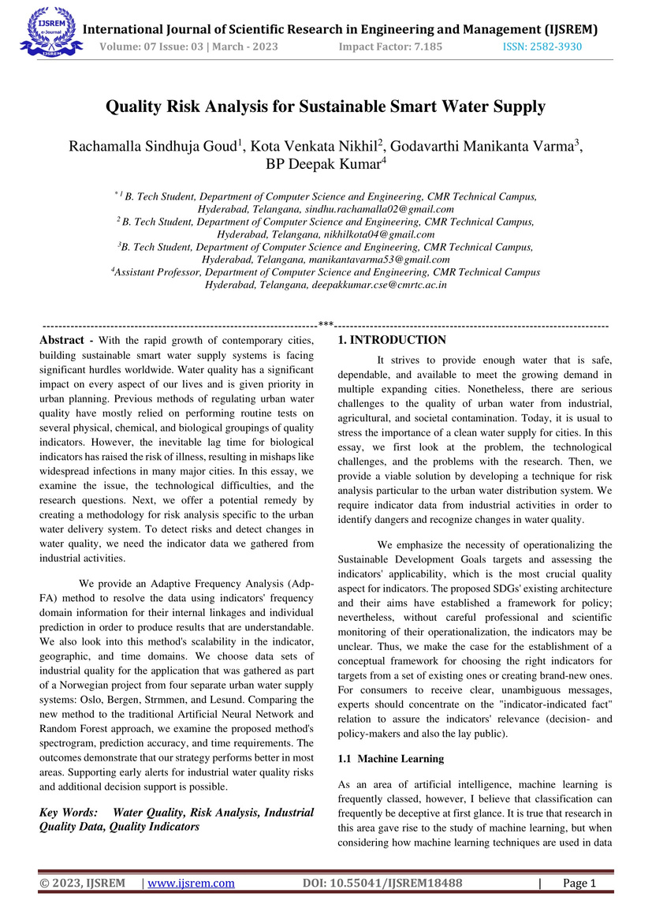
PAPER PUBLICATION

Slide 26
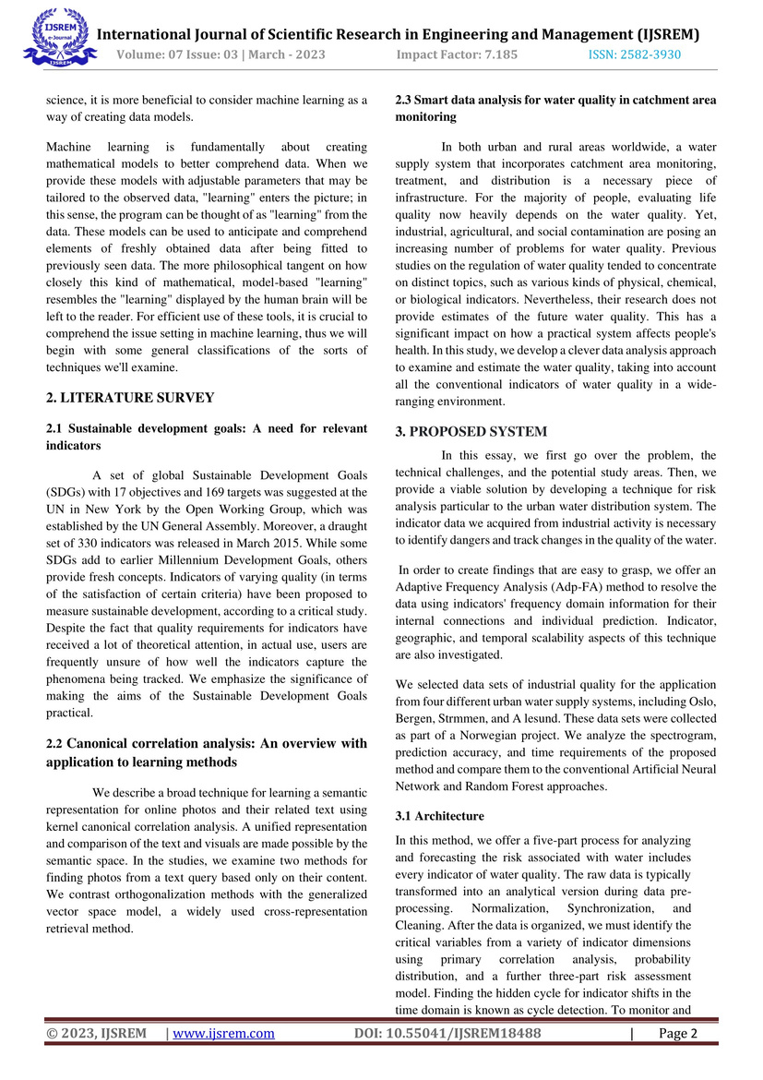
PAPER PUBLICATION

Slide 27
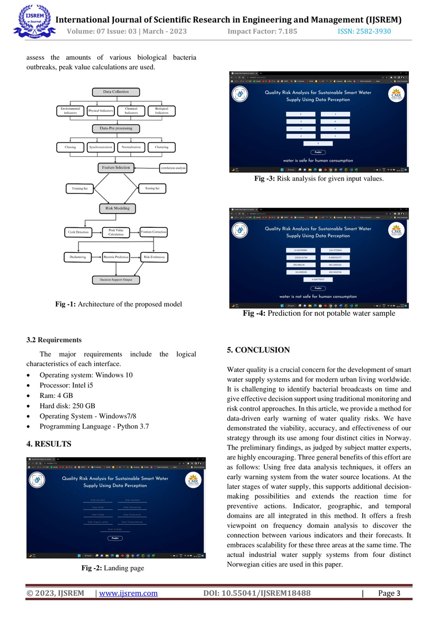
PAPER PUBLICATION

Slide 28
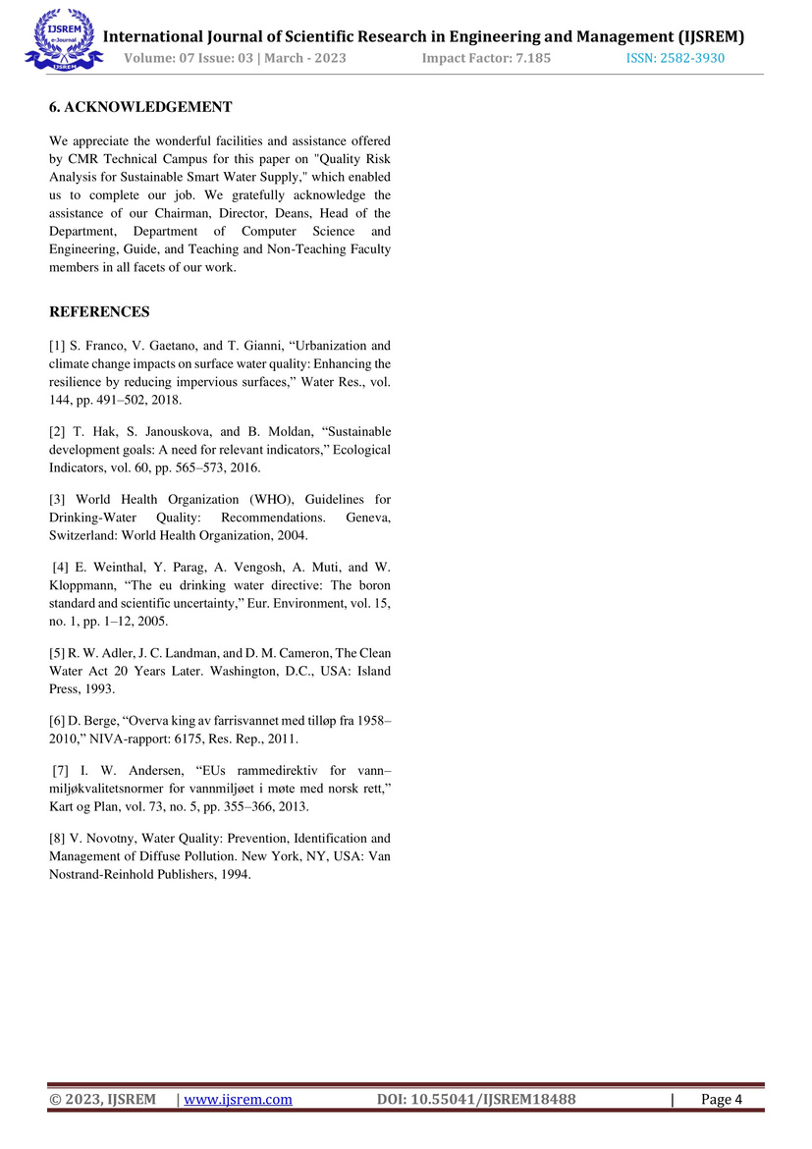
PAPER PUBLICATION

Slide 29
THANK YOU

